Slide 1
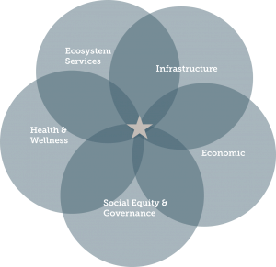
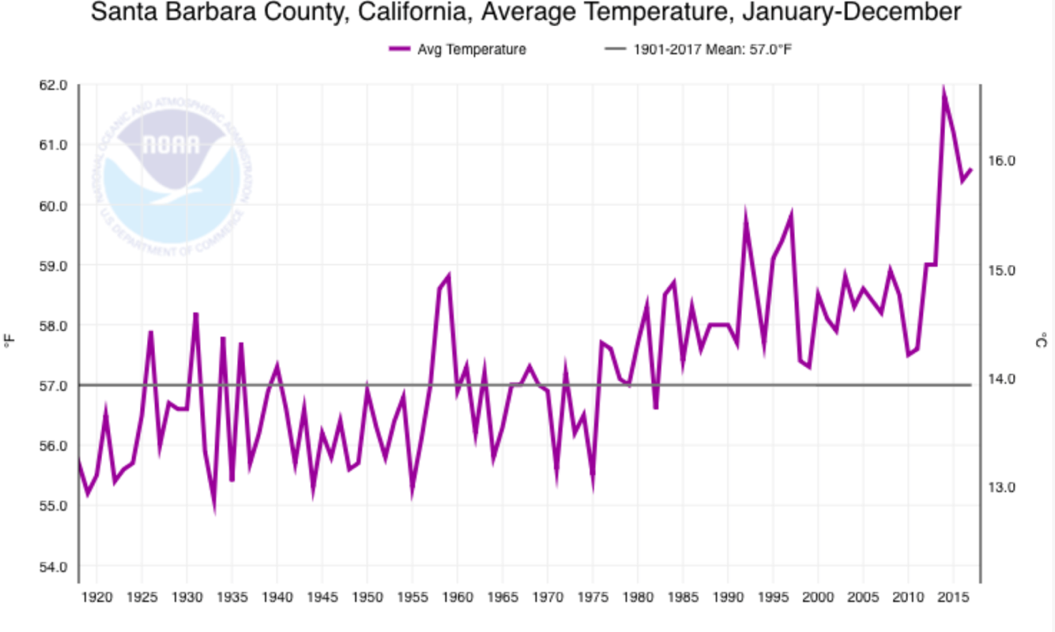
Building Climate Resilience University of California Carbon Neutrality Initiative Fellowship An Nguyen
Introduction
Findings
Results and Outcomes
The Carbon Neutrality Initiative aims to achieve net zero greenhouse gas emissions by 2025. This system-wide initiative not only mitigates the UC contribution to global climate disruption, but also sets an example for the world to follow. The initiative focuses on climate research, improving energy efficiency, increasing renewable energy, and implementing strategies to reduce carbon emissions.
In tandem with the goals of this initiative, it is vital to consider resiliency of our university campuses. It is especially important as the frequency of climate-related impacts increase and our communities become more vulnerable.
UCSB and the Santa Barbara community has experienced a number of climate-related impacts in recent years including a multi-year ongoing drought since 2011; the Thomas Fire in December 2017; Montecito mud slide and debris flow in January 2018 followed by multiple precautionary evacuations in February and March 2018. Later that summer, Southern California including Santa Barbara, proceeded to hit record-high temperatures during a sequence of heat waves.
These events have impacted the UCSB campus in many ways, including poor air quality from ash, smoke and soot causing the closure of campus in December 2017, and freeway closures in December and January impairing access to US highway 101 for students, faculty, and staff.
Considering these past climate change induced events and anticipating future ones, how can UCSB and its surrounding community become more resilient?
What is resilience?
Resilience is the ability of a system or community to survive disruption and to anticipate, adapt, and flourish in the face of change. (1)
Second Nature also says that resilience of any campus or community will be based on its own unique set of characteristics, goals, existing capacity and strengths, and current and future vulnerabilities. Part of developing increased resilience is undertaking the social engagement, assessment, and planning process itself.
What are the current best practices?
By doing research on how a variety of colleges and universities integrate resilience on their campuses,. Most common ways that universities such as Harvard, MIT, UCLA, CSU Chico, and CSU Bakersfield practices resilience include:
Performing vulnerability assessments
Integrating resilience frameworks into their climate action plans and campus planning through the formation of committees and task forces.
How can resilience be scaled to UCSB?
I engaged with a range of stakeholders in order to identify the needs of UCSB. Throughout this process, I built relationships and partnerships with individuals from the following organizations:
Environmental Health and Safety
UCSB Library
Environmental Studies Program Faculty
Staff Assembly
Human Resources and Labor Relations
Goleta Slough Management Committee
EcoVista
What are the relevant climate change impacts at UCSB?
Through my research process, I identified the following issues as most pressing for UCSB’s campus.
Natural disasters (wildfires, mudslides)
Sea level rise
Heat waves
Heat Waves
Historically, Isla Vista’s climate has been moderate. However, climate change is driving up those consistent temperatures. During the summer of 2018, Southern California experienced record high temperatures and regions that are especially vulnerable to heat include California communities not currently acclimatized to increased temperatures and heat events, but who will experience increased high heat days during year. (2) There are many risks that come with heat waves, especially in a highly populated neighborhood with limited air conditioning, such as Isla Vista. Most residents are unaware of the health risks associated with heat waves as well. In light of these issues, I came up with the following:
Report on increasing frequency of heat waves and potential solutions
Research protocol of qualitative student interviews and surveys to identify impacts of heat waves on UCSB and neighboring Isla Vista community
Informative guide for community members to stay healthy and safe during heat waves
Draft citizen science project to obtain quantitative temperature data in local apartments and homes
Sea Level Rise
I captured information on the capacity of local projects to mitigate sea level rise. One included UCSB’s North Campus Open Space. I also developed a partnership with the Goleta Slough Management Committee to help revamp their website. I produced educational content for the community on:
Climate change and local impacts
Sea level rise
Affected endangered species
Involved organizations
Community Response to Resilience
In relation to on-going, anthropogenic climate change, disaster makes the distribution of vulnerability apparent and visible. Santa Barbara faces a large range of impacts from anthropogenic climate change, including a range of natural disasters. Asking the question of what UCSB can do to aid our community in the future, I did the following:
Identified best practices on administrative leave for employees to volunteer in times of emergencies from Lehigh University and the University of Connecticut
Engaged with stakeholders in the vetting stage to understand campus need
Developed a proposal for UCSB to create local procedures to fill in the gap of the UC wide policy
Rising Average temperatures in SB County
NOAA
Flames from Thomas Fire above Highway 101.
Ray Ford // Nooshawk photo
Debris on Highway 101 after powerful storm in Montecito on January 9, 2018.
Al Seib // Los Angeles Times
Project Goals
For this fellowship, I sought to research ways that the UCSB campus can increase resilience to future climate impacts, with a focus on evaluating how recent and future events impact UCSB students and the community at large.
Define resilience through collecting current best practices from other colleges and universities.
Develop relationships with campus and local community stakeholders.
Identify opportunities on campus and in the community to take action and implement programs.
Produce materials to educate and raise awareness on local climate resilience.
Literature Cited
Acknowledgements
“Climate Resilience.” Second Nature, secondnature.org/climate-resilience/.
Seville, Aleka, and Nik Steinber. “California Heat and Health Project: A Decision Support Tool.” Four Twenty Seven, 16 Dec. 2016, 427mt.com/wp-content/uploads/2017/01/427_CA_HeatHealth_DecisionTool_UserNeedsAssessment-1.pdf.
Advisor: Katie Maynard, UCSB Sustainability Coordinator
Faculty Advisor: Summer Gray, Department of Environmental Studies
Notes:
Phase II: In-depth assessment (similar to LEEDS) and information exchange with entire research group. Inform staff of support services, shared equipment, onservation impact, altered techniques or materials. Inquire: needs and concerns
Phase III: Follow up

